Slide 1
City University Presentation on Network Design of BASIS Course Title : Computer Networks Laboratory Course Code : CSE 318
Submitted To
Pranab Bandhu Nath
Senior Lecturer,
Department of CSE
City University.
Submitted By
Md Selim Hossain
181472561
47th Batch

Slide 2
Overview:
Introduction
Project Plan
Logical Diagram , BASIS Floor-01
Physical Diagram
Logical Diagram, BITM Floor-02
Physical Diagram
Components used in the project
Device Cost
physical security
Advantage of Network design
Disadvantage of Network design
Conclusion
Assemble Screen Shot

Slide 3
Introduction:
Extensive planning should go into a network implementation. Just like any project, need is identified and then a plan outlines is process from beginning to end. A good project plan will help identify any strengths, weaknesses, opportunities, or threats. The plan should clearly define the tasks, and the order in which tasks are completed. In this project I have tried to draw a schematic Working model of an office.

Slide 4
Project Plan:
It is important to have a formal planning procedure for any nontrivial project. Before creating a project, we need to determine what we will use the project for. After that the components have to be determined according to the work. Every task from start to finish has to be completed step by step. All the PCs that we will use in this project will be able to communicate with each other. The PCs will be connected via CAT-6 UTP cable and switch. We will use 2 servers here. Web server and DNS server. I will use the web server to communicate between the client and the server using HTTP and the computers will have a DNS server to communicate with each other by translating the numeric IP addresses.

Slide 5
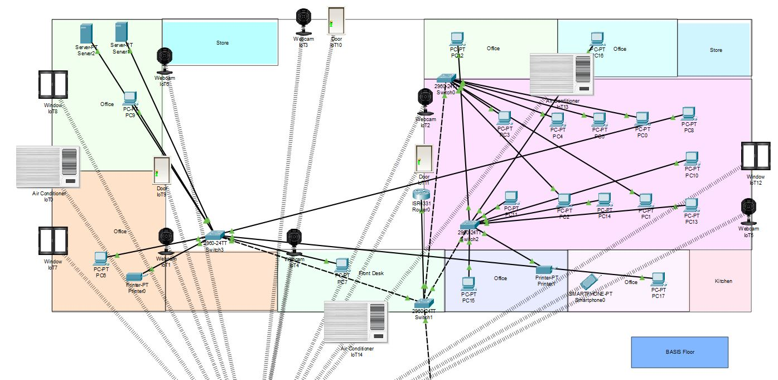
Logical Diagram BASIS Floor: 01

Slide 6
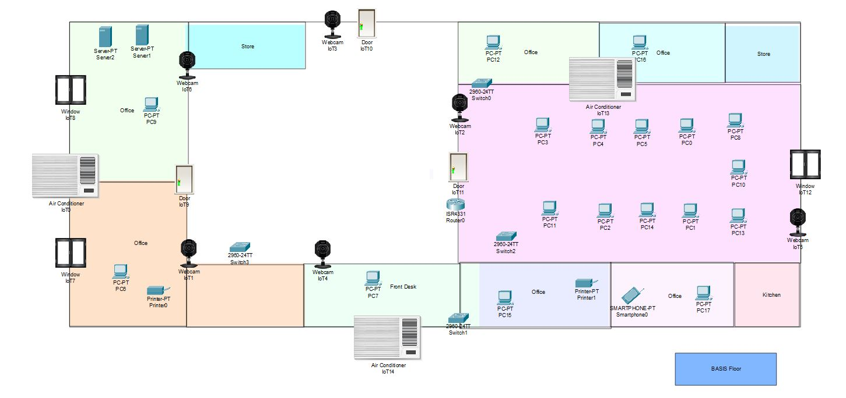
Physical Diagram:

Slide 7
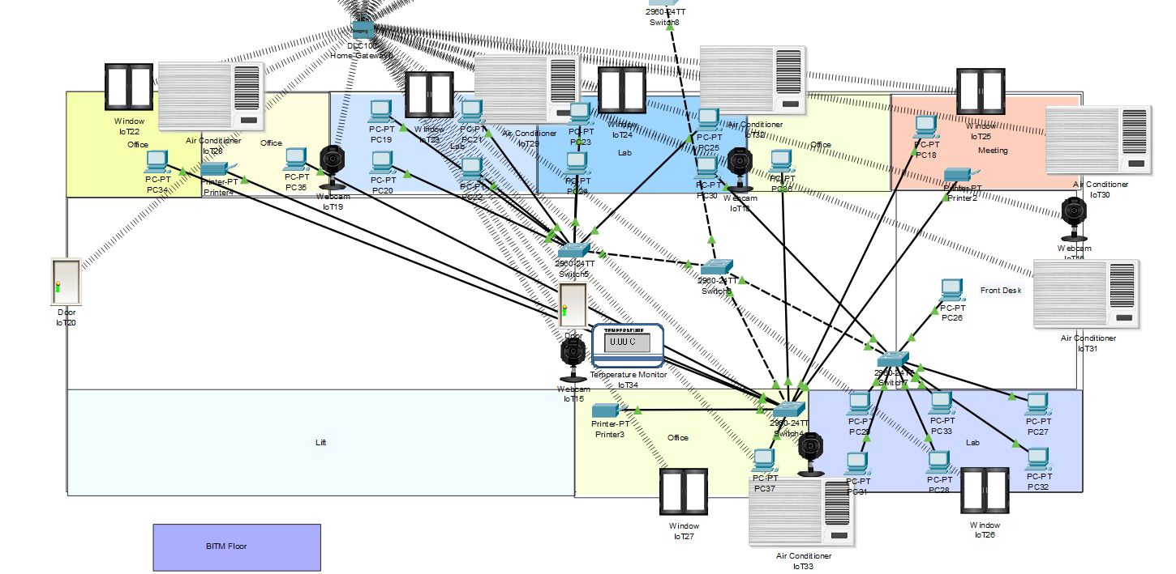
Logical Diagram BITM Floor: 02

Slide 8
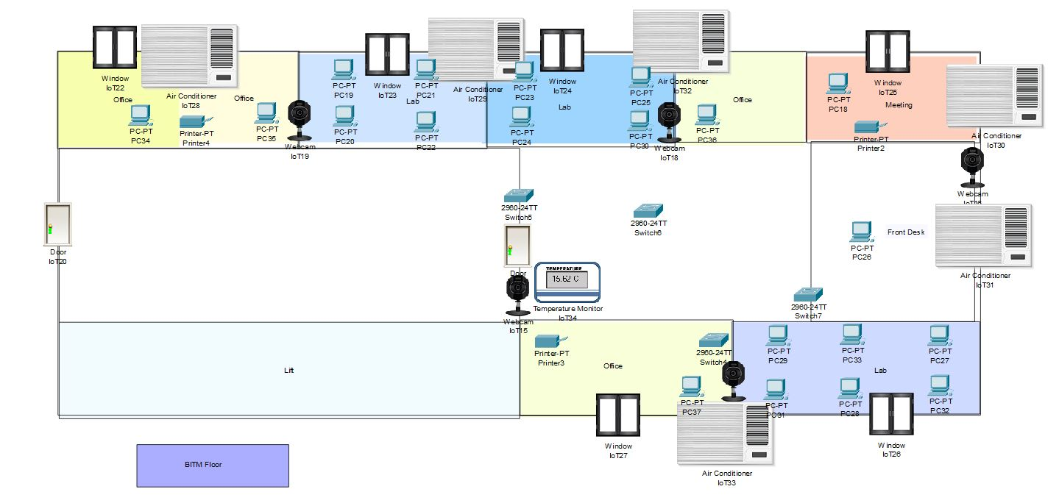
Physical Diagram:

Slide 9
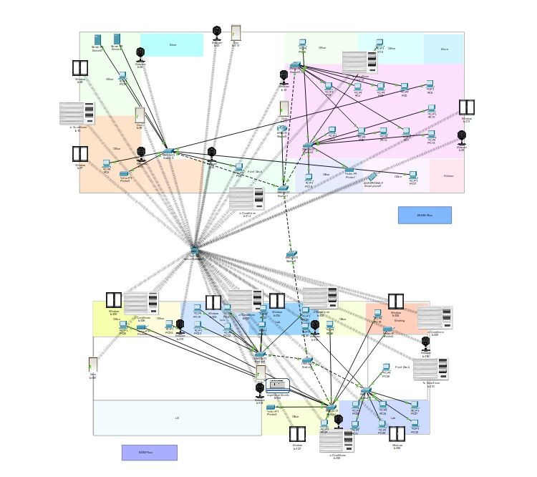
Full Overview

Slide 10
Components used in the project :
As it is a project purely based on networking so we have used all the basic components related to it. which includes –
Router
Switches
Connecting cables
Printer, Servers
End devices (laptops and computers).

Slide 11
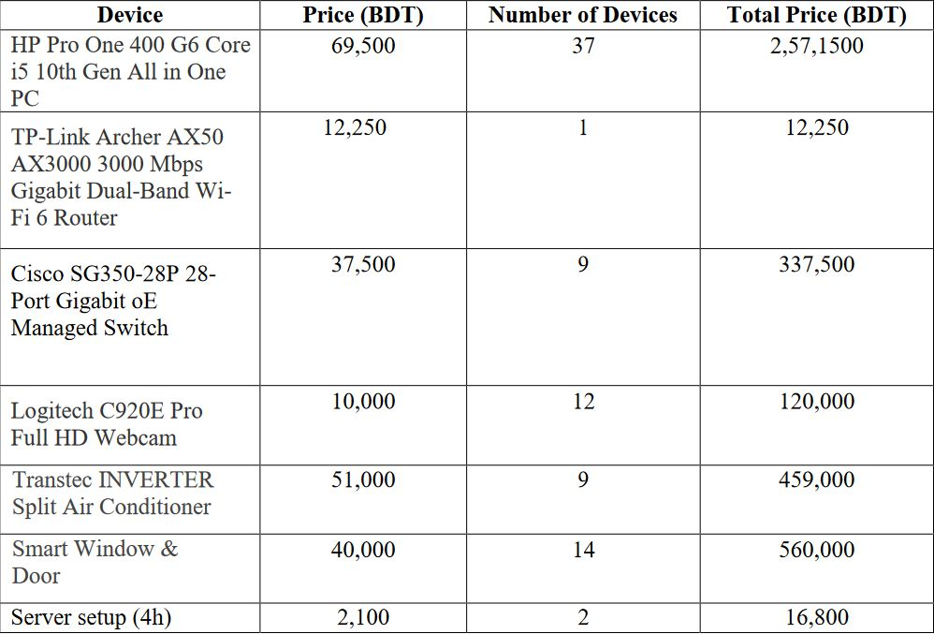
Device Cost:

Slide 12
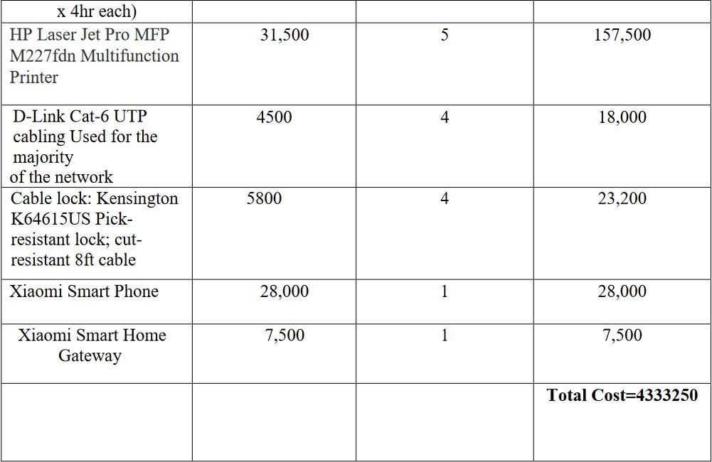
Device Cost:

Slide 13
physical security:
The first level of security in any computer network is physical security. Physical security is important for workstations but vital for servers. We have to take some step to make security strong. They are
Lock the computer room.
Give the keys only to people you trust.
Keep track of who has the keys.
Mount the servers on cases or racks that have locks.
Disable the floppy drive on the server.

Slide 14
Advantage of Network design:
Efficient Network Performance.
Allows Resilience.
Makes Room for Scalability.
Work Collaboration Made Easier.
Speed Increase.

Slide 15
Disadvantage of Network design:
The approach may not take all necessary applications and services into consideration, leading to a design that ultimately may not meet the needs of an organization, and may need to be redesigned in the future.

Slide 16
Conclusion:
A secure network diagram needs to be created for network design. Because the success of an organization depends on its network security. It has been used to logically group clients on the network, and with the aid of a router and switch configurations, data packets routed from one device to another. It is also noteworthy that, the configuration and specifications are for the initial prototype and can further be developed and additional functionality can be added to increase support and overage. The procedures provide a veritable approach for the design of LANs for end-to-end IP network connectivity.

Slide 17
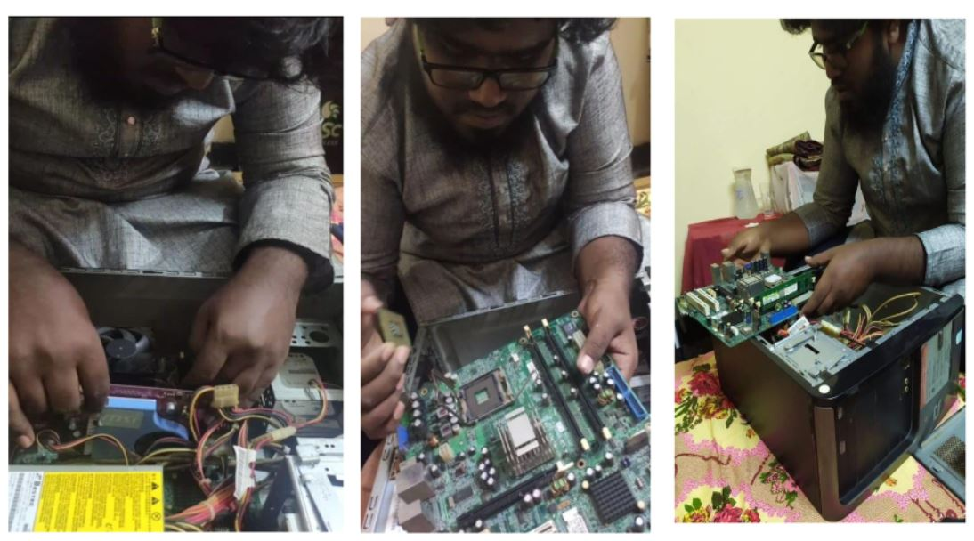
Assemble Screen Shot:

Slide 18
Thank You

